Slide 1
SQL Server
Advanced Queries
In all slides, db=database

Slide 2
Subquery
A subquery is a normal T-SQL query that is nested inside another query.
They are created using parentheses when you have a SELECT statement that serves as the basis for either part of the data or the condition in another query.
Subqueries are generally used to fill one of a couple of needs:
  Break a query up into a series of logical steps
  Provide a listing to be the target of a WHERE clause together with [IN|EXISTS|ANY|ALL]
  To provide a lookup driven by each individual record in a parent query

Slide 3
Nested Subquery
A nested subquery is one that goes in only one direction—returning either a single value for use in the outer query, or perhaps a full list of values to be used with the IN operator.

Slide 4
Nested Subquery for Single Values
Using the Northwind database, run the following query:
The inner query
(SELECT MIN...)
retrieves a single
value for use in
the outer query.
Since we’re using
an equals sign, the inner query absolutely must return only one column from one single row, or you will get a runtime error.
SELECT DISTINCT o.OrderDate, od.ProductID
FROM Orders o
JOIN [Order Details] od
ON o.OrderID = od.OrderID
WHERE o.OrderDate = (SELECT MIN(OrderDate) FROM Orders)

Slide 5
Nested Queries Using Subqueries That Return Multiple Values
Using pubs, we want a list of all the stores that have discount records.
The stores are in a table called stores. The discounts are in a table called discounts.
Here we have used the IN for multiple values
SELECT stor_id AS 'Store ID', stor_name as 'Store Name'
FROM stores
WHERE stor_id IN (SELECT stor_id FROM discounts)

Slide 6
Nested Queries Using Subqueries That Return Multiple Values cont.
In this instance, a JOIN
will provide the same
results.
For performance
reasons you want to
use the join method
as your default
solution if you don’t
have a specific reason for using the nested SELECT.
SELECT s.stor_id AS ‘Store ID’, stor_name AS ‘Store Name’
FROM Stores s
INNER JOIN Discounts d
ON s.stor_id = d.stor_id

Slide 7
Using an OUTER JOIN to Find Orphaned Records
Previously, we used an Outer Join to find orphaned records:
SELECT s.stor_name as 'Store Name'
FROM discounts d
RIGHT OUTER JOIN stores s
ON d.stor_id = s.stor_id
WHERE d.stor_id IS NULL

Slide 8
Using a Nested SELECT to Find Orphaned Records
This type of nested SELECT is nearly identical to our previous example, except that we add the NOT operator.
The difference this makes when you are converting to join syntax is that you are equating to an outer join rather than an inner join.

Slide 9
Using a Nested SELECT to Find Orphaned Records
Using a nested SELECT would give us the following:
SELECT stor_id AS ‘Store ID’,
stor_name AS ‘Store Name’
FROM Stores
WHERE stor_id NOT IN
(SELECT stor_id FROM Discounts WHERE stor_id IS NOT NULL)

Slide 10
Correlated Subqueries
With correlated subqueries, the inner query runs on information provided by the outer query, and vice versa.
This takes a 3 step process:
    The outer query obtains a record, and passes it into the inner query.
    The inner query executes based on the passed in value(s).
    The inner query then passes the values from its results back out to the outer query, which uses them to finish its processing.

Slide 11
Correlated Subqueries cont.
We want to know the OrderID(s) and OrderDate of the first order in the system for each customer.
On Northwind, we want to know the first day that a customer placed an order and the IDs of those orders.

Slide 12
Correlated Subqueries cont.
First, we want the OrderDate, OrderID, and CustomerID for the Orders table in our results, so we know that we our query will have at least that table.
Next, we need to know what the first date in the system was for each customer. That’s where the tricky part comes in - now we need a value that’s by individual customer.

Slide 13
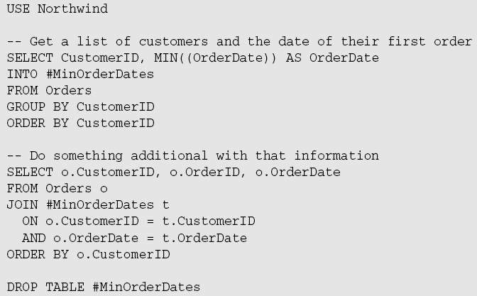
Correlated Subqueries cont.
This wouldn’t be that big a deal if we were to do it in two separate queries—we could just create a temporary table, and then join back to it.
Sometimes
using this
two-query
approach is
simply the
only way to
get things done
without using
a cursor—this is
not one of those
times.

Slide 14
Correlated Subqueries cont.
If we want this to run in a single query, we need to find a way to look up each individual.
We can do this by making use of an inner query that performs a lookup based on the current CustomerID in the outer query.
We will then need to return a value back out to the outer query so it can match things up based on the earliest order date.

Slide 15
Correlated Subqueries cont.
SELECT o1.CustomerID, o1.OrderID, o1.OrderDate FROM Orders AS o1 WHERE o1.OrderDate = (SELECT Min(o2.OrderDate) FROM Orders AS o2 WHERE o2.CustomerID = o1.CustomerID) ORDER BY CustomerID
Only one query plan had to be executed.
The outer query (in this example) looks pretty much just like a nested subquery. The inner query, however, has an explicit reference to the outer query (notice the use of the “o1” alias).
Aliases are used in both queries—even though it looks like the outer query shouldn’t need one—because they are required whenever you explicitly refer to a column from the other query (inside refers to a column on the outside or vice versa).

Slide 16
Correlated Subqueries in the SELECT List
Subqueries can also used to provide a different kind of answer in your selection results.
Now we’re after just the name of the customer and the first date on which they ordered something.
We’re now asking for the customer’s name, which means that we have to bring the Customers table into play.
We no longer need to build any kind of condition in—we’re asking for all customers and we just want to know when their first order date was.

Slide 17

Correlated Subqueries in the SELECT List cont.
Looking through the results, we see some have a NULL value:
SELECT cu.CompanyName,
(SELECT Min(OrderDate)
FROM Orders o
WHERE o.CustomerID = cu.CustomerID)
AS "Order Date"
FROM Customers cu

Slide 18
IsNull()
ISNULL()accepts a variable or expression and tests it for a null value.
If the value is indeed NULL, then the function returns some other pre-specified value.
If the original value is not NULL, then the original value is returned.

Slide 19

IsNull & CAST()
SELECT cu.CompanyName,
ISNULL(CAST ((SELECT MIN(o.OrderDate)
FROM Orders o
WHERE o.CustomerID = cu.CustomerID)AS varchar),'NEVER ORDERED')
AS "Order Date"
FROM Customers cu
Because the first row starts off returning a valid date, the column Order Date is assumed to be of type DateTime.
But when we get to our first ISNULL, there is an error generated since NEVER ORDERED can’t be converted to the DateTime datatype. CAST() can help you with problems like this.

Slide 20
CAST() vs. CONVERT()
To convert an expression from one data type to another– example: convert a datetime type to a varchar type; CONVERT or CAST can be used.
CONVERT is specific to SQL Server.
CAST can be used in other database applications.
CONVERT offers some date formatting options not offered by CAST

Slide 21
CAST() vs. CONVERT()
CAST Syntax:
  CAST ( expression AS data_type [ ( length ) ] )
CONVERT Syntax:
  CONVERT ( data_type [ ( length ) ] , expression [ , style ] )

Slide 22
Derived Tables
Sometimes you need to work with the results of a query
  You want to be able to treat the results of a subquery as a table and JOIN the results of the subquery to other tables
Solution?
  Create a derived table

Slide 23
Derived Tables
How do we do this?
  We assign a name to our subquery results
  After the subquery is “named”, we can refer to it like a table within our outer query
To create our derived table, we need two things:
  To enclose our query that generates the result set in parentheses
  To alias the results of the query

Slide 24
Derived Tables
SELECT DISTINCT c.CompanyName
FROM Customers AS c
JOIN
(SELECT CustomerID
FROM Orders AS o
JOIN [Order Details] AS od
ON o.OrderID = od.OrderID
JOIN Products AS p
ON od.ProductID = p.ProductID
WHERE p.ProductName = ‘Chocolade’) AS spen
ON c.CustomerID = spen.CustomerID
JOIN
(SELECT CustomerID
FROM Orders AS o
JOIN [Order Details] AS od
ON o.OrderID = od.OrderID
JOIN Products AS p
ON od.ProductID = p.ProductID
WHERE ProductName = ‘Vegie-spread’) AS spap
ON c.CustomerID = spap.CustomerID
Using Northwind, create
a query that returns
the company name of
all companies that
have ordered
‘Chocolade’ AND
‘Vegie-Spread’.
We are combining
what we have learned
about JOINS with
derived tables

Slide 25
The EXISTS Operator
SQL Server offers an operator called EXISTS
When you use EXISTS, you don’t really return a result set —instead, you return a simple TRUE/FALSE regarding the existence of data that meets the criteria established in the query that the EXISTS statement is operating against.

Slide 26
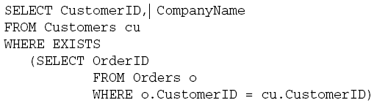

The EXISTS Operator cont.
Compare the following queries to find a customer who placed at least one order:
Both queries work, but when EXISTS is used, SQL Server doesn’t have to perform a full row-by-row join.
Instead, it can look through the records until it finds the first match and stop right there. As soon as there is a single match, the EXISTS is true, so there is no need to go further.

Slide 27
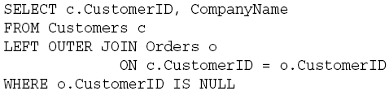
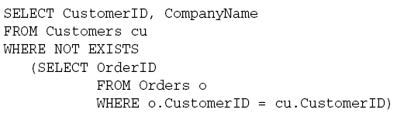
The EXISTS Operator cont.
What would once be a complicated query to find all customers who haven’t placed an order using joins:
Now can be rewritten using EXISTS and NOT:

Slide 28
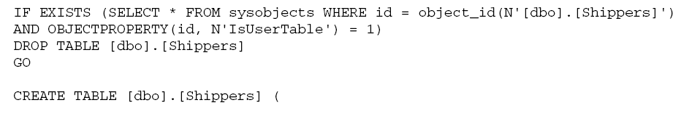
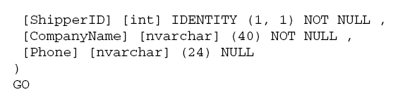
EXISTS cont.
One common use of EXISTS is to check for the existence of a table before running a create statement.

Slide 29
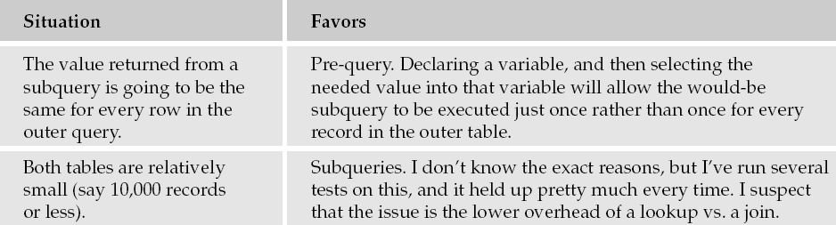

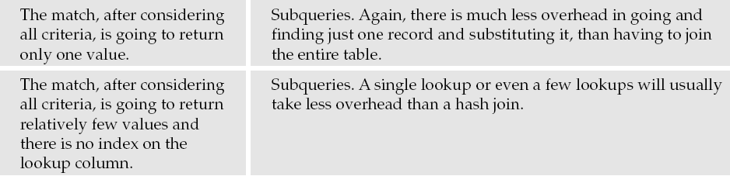
Joins vs. Subqueries for Performance

Slide 30
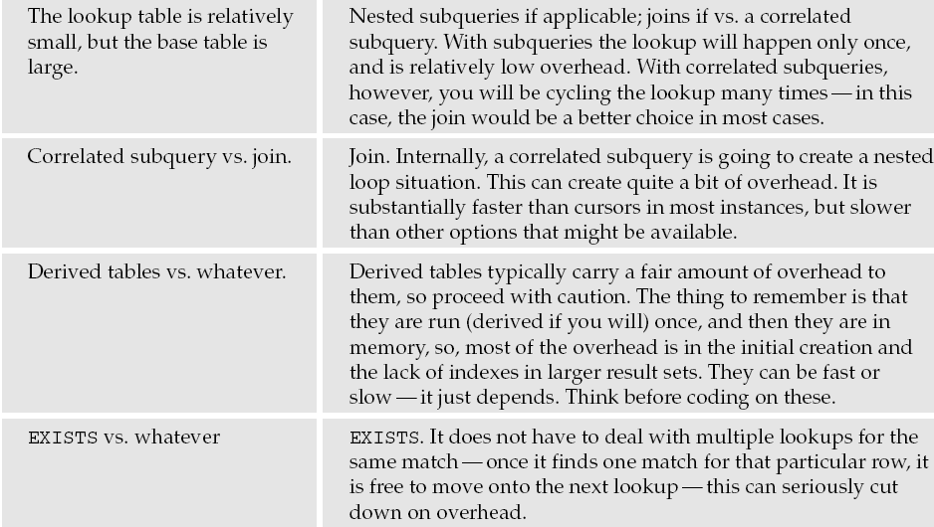
Joins vs. Subqueries for Performance cont.

